Slide 1
Keeping Valuables Safe:
Why, Where, and How to Discuss Patient Care
A Presentation for the CT Society for Healthcare Risk Management

Slide 2

Joey Mattson
Marrielle Van Rossum
Devine Millimet, Manchester, NH

Slide 3
First things first:
We are not Connecticut lawyers. Joey and Marrielle practice in New Hampshire, and Marrielle is barred in Massachusetts and Maine. There is a lot of overlap and similarities within these jurisdictions, and we can all learn from each other, but we are not holding ourselves out as experts of Connecticut law.

Slide 4

Objectives
Learn the basics of tracking electronic information & why it is critical for proper evaluation of a claim or lawsuit.
Identify problems that can arise when electronic information isn’t adequately searched.
Discuss tactics to help explain to providers why it is critical that patient-related communications occur through official channels only.

Slide 5
Typical Request for Production of Documents:
Please produce copies of all medical records, annotations, radiology logs, radiological images, diagnostic testing, films, scans and studies, digital and electronic monitoring records, alarm logs, orders, lab requests, lab results, reports, memoranda, correspondence, recordings, tapes, notes, emails, faxes, and telephone records, including, but not limited to, all handwritten, digital, imaging, audio and video records, and all other documents relating to John Doe.

Slide 6

How do we communicate about patients?

Slide 7
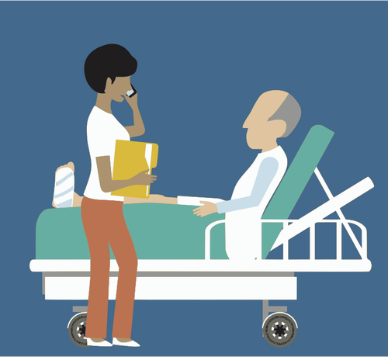
The law defines “document” broadly--it’s not just the chart!
Let us count the ways:
Emails (enterprise v. persona)
Web pages (patient portals)
Word processing documents
Voicemail
Chart entries
Messaging applications (e.g., Voalte, Klara, TigerText, Zinc, QliqSoft, and Spok)
Text message
Phones–cell and landline
Oral communications
Calendars and scheduling software

Slide 8
Where do I look for documents?
Where do you find documents and data?
Hard drives
Network drives
Server drives
Flash memory
Optical drives
Backup tapes
Laptops and Desktops
Cell phones
Tablets

Slide 9
Yes–you’ll need IT!

Slide 10
Scattered
Communication
Complicated
Risk Management

Slide 11

What is the story of each patient?
Eventually you may have to justify the care that each patient received.

Slide 12
Tracking Electronic Information
How did the patient end up at your facility?
Who was involved at your facility?
Where did the patient go after discharge? Were there follow-ups at different departments
within your system?
Is there a remaining care-based link between your facility and the patient?
Is there facility-specific paper records?
Do your providers have any personal paper or electronic records?

Slide 13

Pitfalls: Case Examples

Slide 14
Case of the ICU email
Case of the taped phone call
Case of the accidental PCP
Case of the missing cell phone calls, and how additional records can save the defense

Slide 15
Training your staff
Communications about patients should be in the chart whenever possible!
Oral communications are essential–but they should end up in the record if they’re essential!
Watch auto-populated fields and “carried forward” information.

Slide 16
Questions?
Joey Mattson - jmattson@devinemillimet.com
Marrielle Van Rossum - mvanrossum@devinemillimet.com

